Slide 1
Predicting Stock Exchange Price
Jamelah Guimba C0853807
Ricardo Chacón C0854802
Sulabh Shrestha C0841540
JRS Corp.
March 28, 2022

Slide 2
Agenda
01. Introduction
02. Motivation
Establishment of this project?
Why did we choose this field?
03. Preparation
04. Training
05. Conclusion
What methods did we use?
Which Model did we use?
Closing remarks.

Slide 3

Introduction
We are predicting stock prices of popular exchanges. This is machine learning project. We have use pandas, nampy, and various method of scikit learn.

Slide 4

Motivation

Slide 5
Motivation
<add here>

Slide 6
Preparation
1. Data Procuring
2. Data Identifying
3. Data Cleaning
We took data from Kaggle
We selected NASDAQ for our model
To remove null values

Slide 7
Preparation
4. Data Imputation
5. Identify Features
6. Data Splitting
To convert Date format from String to Date
To use Columns ‘Date’ and ‘Close’
Split data in 70/30 ratio

Slide 8


Training
Linear Regression
Decision Tree
Random Forest

Slide 9
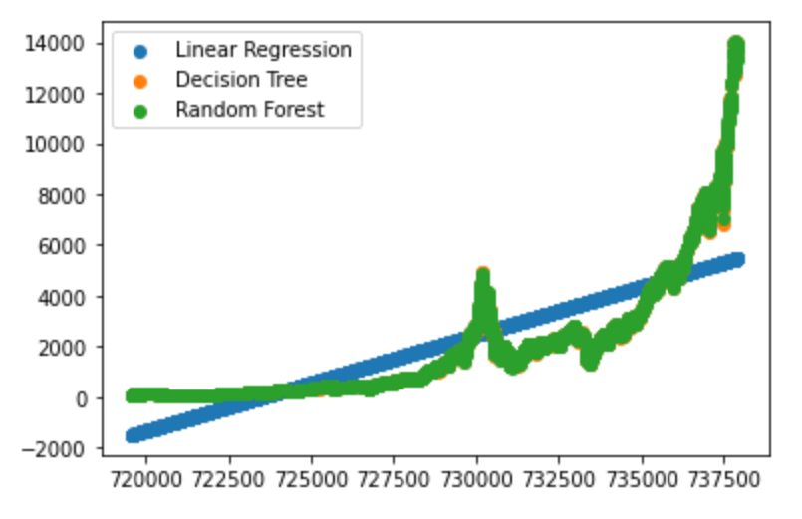
Results

Slide 10
Conclusion
We identify the problem
We created model
We analyze the data
We analyze the model
We pre-processed the data

Slide 11

Thank you
Any question or feedback?
JRS Corp.

